Slide 1

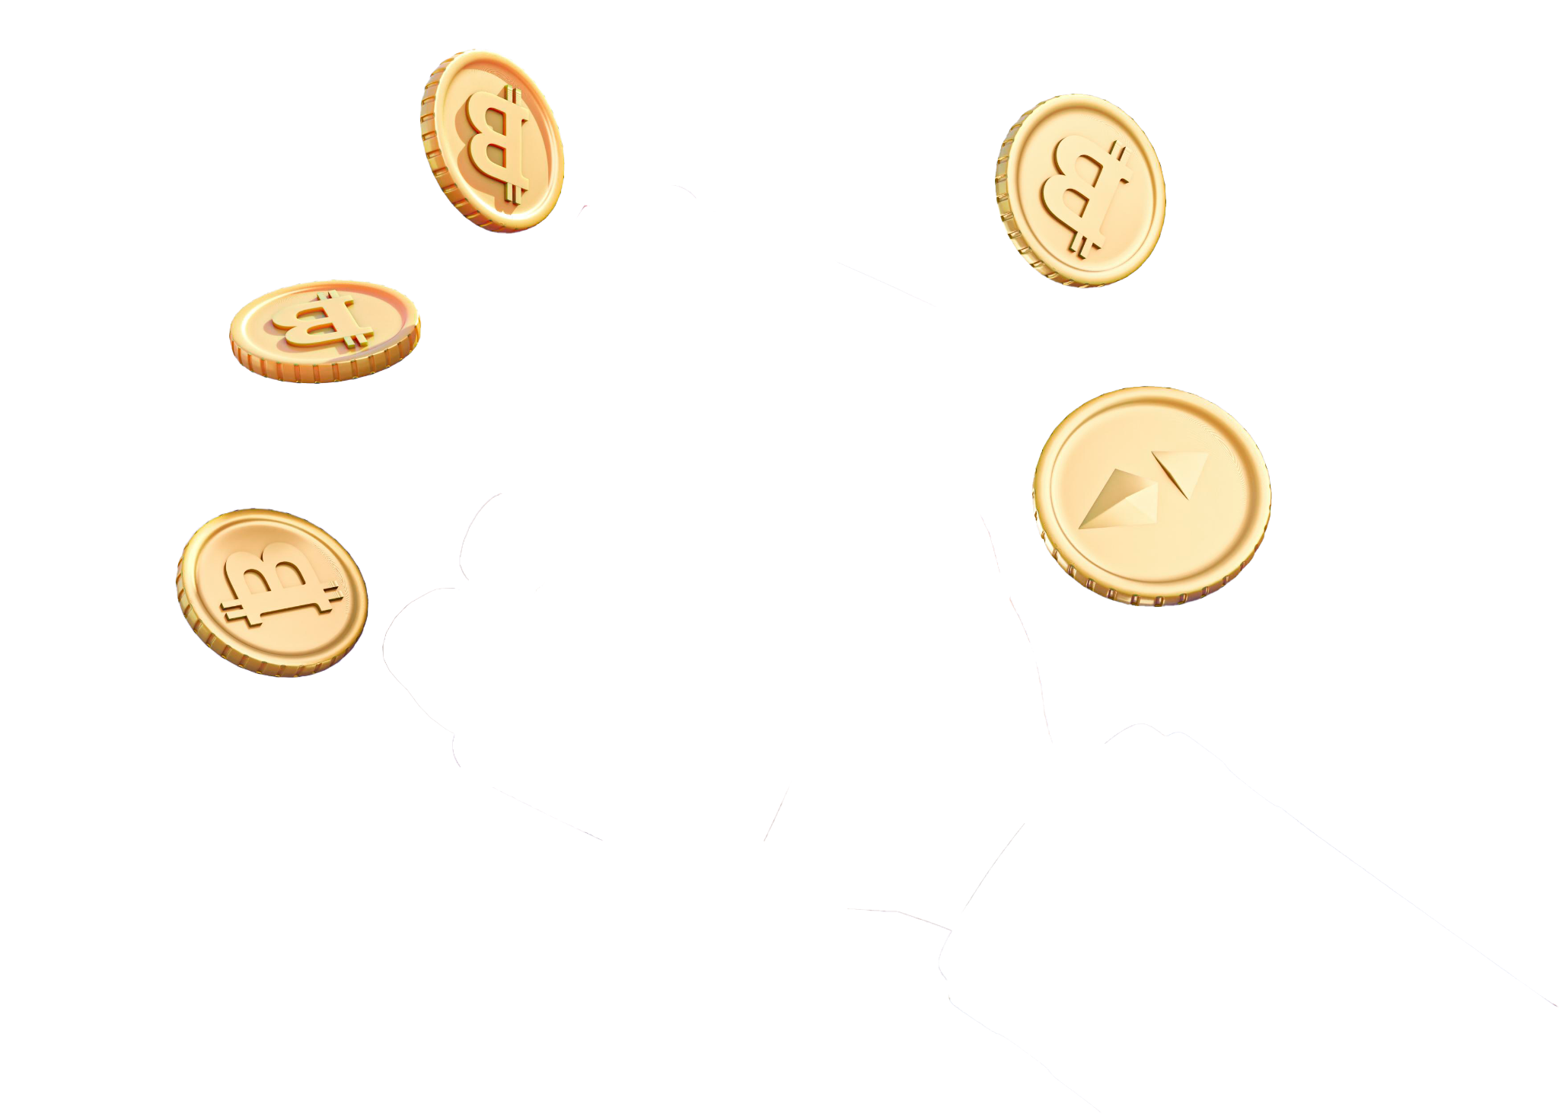
The New Economy: Cryptocurrencies
Data Science For All: Team 22

Slide 2



Team 22
Oscar Cazalez
Emerson Moniz
Jimmy Blezin
LinkedIn Profile
LinkedIn Profile
LinkedIn Profile
Notes:
Team does a quick introduction
Oscar-Chicago, Team Lead
10 pm ct
11 pm est

Slide 3
Wealth Gap in PERSPECTIVE
1%
49%
8.3%
The top 1% have grabbed 38% of all additional wealth accumulated since the mid-1990s, while the bottom 50% captured just 2%.
49% of both Hispanics & African Americans U.S adults don’t currently own individual stocks, mutual funds, bonds, ETFs, Cryptocurrency or real estate.
It is estimated that 27 million people, 8.3% of America’s total population, currently own cryptocurrency.
Notes:
https://fortune.com/2021/12/07/worlds-richest-inequality-richer-during-pandemic/#:~:text=The%20top%201%25%20have%20grabbed,of%20it%2C%20the%20report%20found.
America’s top 1% holds more than half the national wealth invested in stocks
What is the wealth gap, who is affected, what are alarming statistics ? and
mutual funds.

Slide 4
Poverty in CONTEXT
01
02
03
04
The Family’s 2020 poverty threshold(below) is $31,661
In 2020, the average wealth gap in US population is .48 (Gini Coefficient)
11.3% of the total US population lived below the poverty threshold in 2020.
In 2020, 37.25 million Americans lived below the poverty line in the US
Notes:
Total Population in the United States(329.5 Million)
https://www.census.gov/topics/income-poverty/poverty/guidance/poverty-measures.html#:~:text=Step%201%3A%20Determine%20the%20family's,threshold%20(below)%20is%20%2431%2C661.
https://www.statista.com/statistics/233138/number-of-people-living-below-the-poverty-in-the-us/#:~:text=In%202020%2C%20about%2037.25%20million,line%20in%20the%20United%20States.
A score of zero would reflect perfect income equality and a score of 1 indicates a society where one person would have all the money and all other people have nothing.
Value of the dollar decreasing
Inflation over all
Last 5 years is credible
Index fund
the

Slide 5
PROBLEM
Decrease the wealth gap in America by providing minorities with a data science tool that aids in predicting future movements of cryptocurrencies with accompanying resources to educate on the potential of blockchain technology.

Slide 6
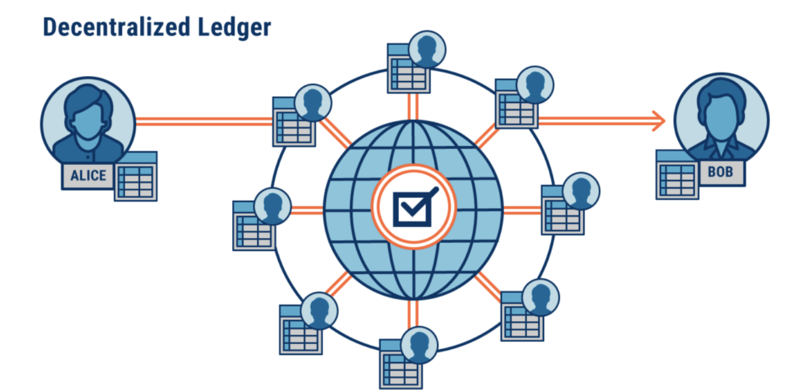
Blockchain Technology
Creation
Applications
Global GDP
2008
Limitless Uses
20 Billion or around 0.025% is held in the blockchain
Notes:
https://www.weforum.org/agenda/2016/06/blockchain-explained-simply/
Risk
Pros and cons

Slide 7
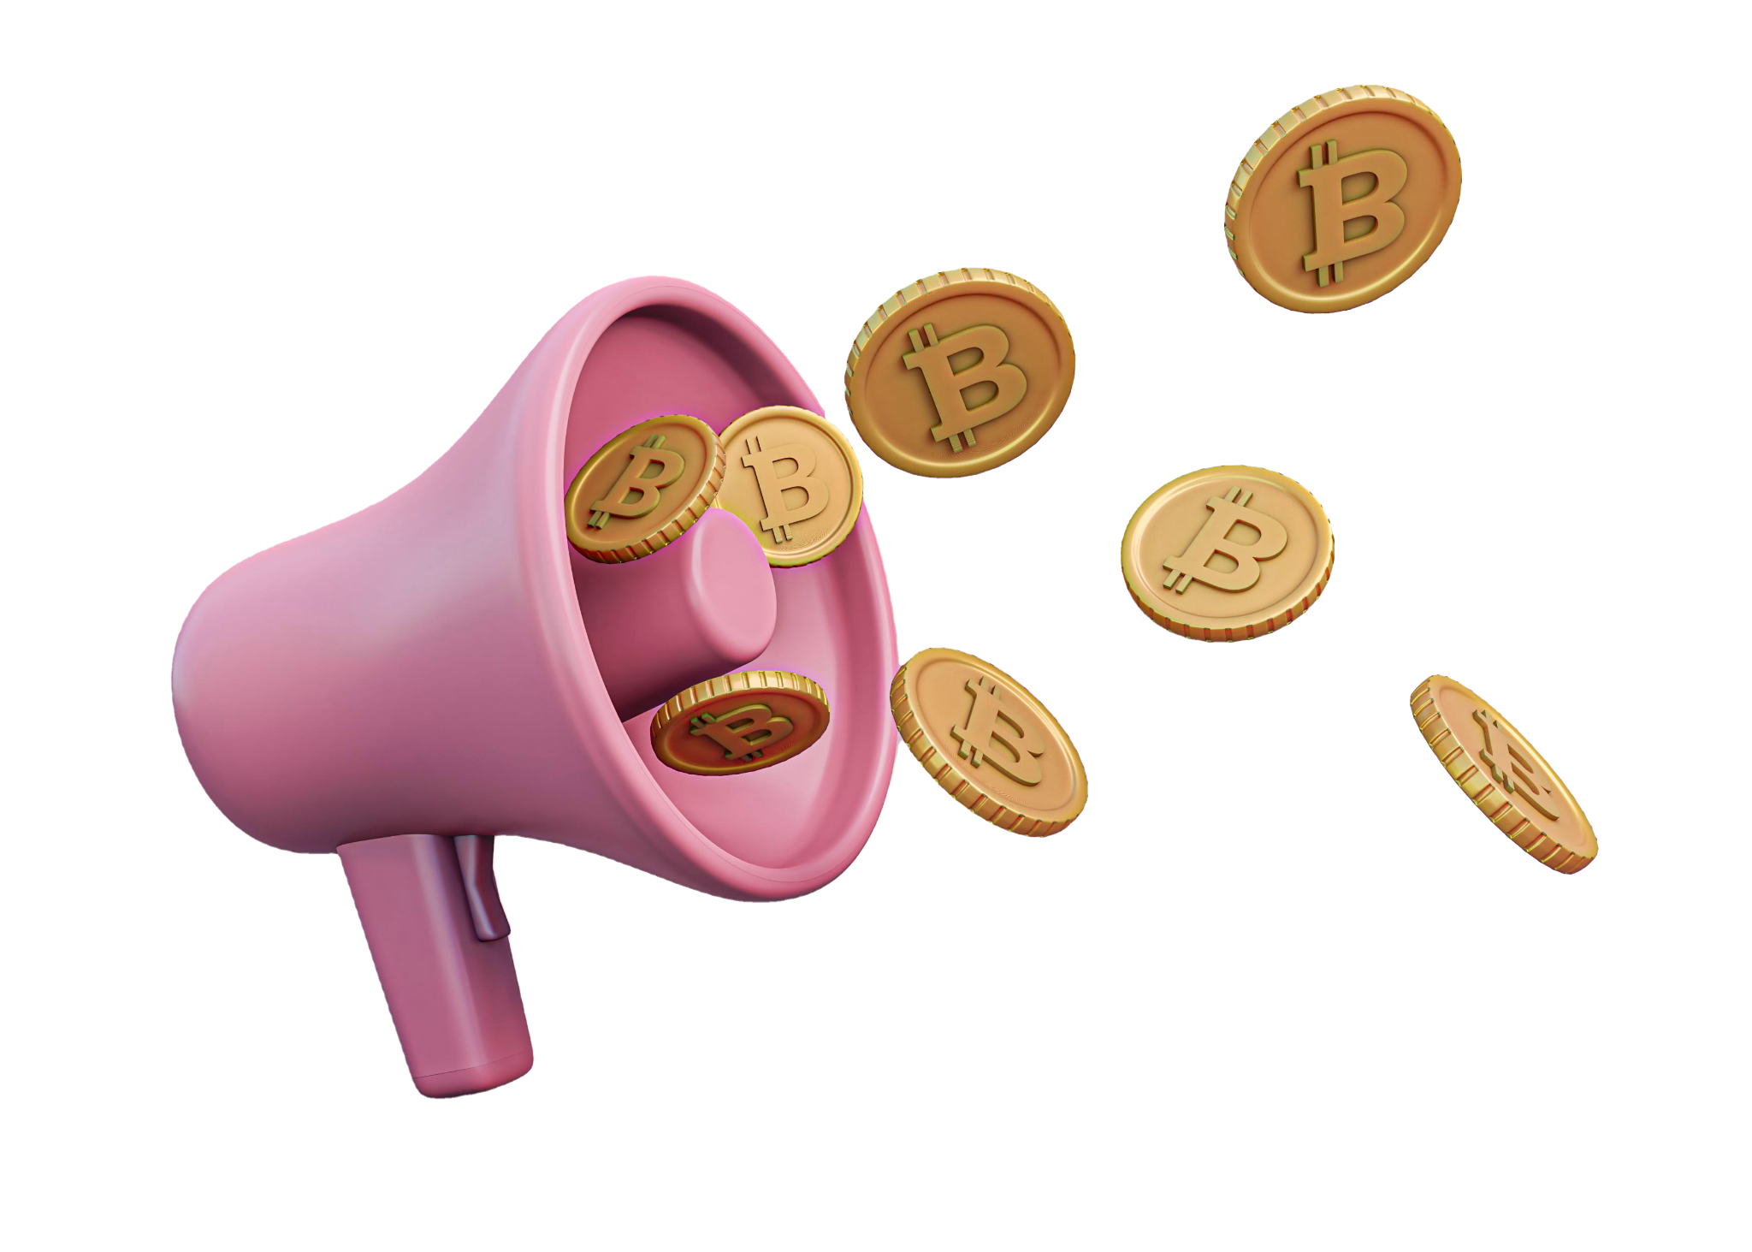
Methodology
Dataset
Kaggle Crypto Forecasting Dataset
Scraped Web for additional data
Coinbase
CoinMarketCap
Blockchain
Tools
Pandas
Python
Jupyter/Colab
Arima Predictive Model
Tableau

Slide 8
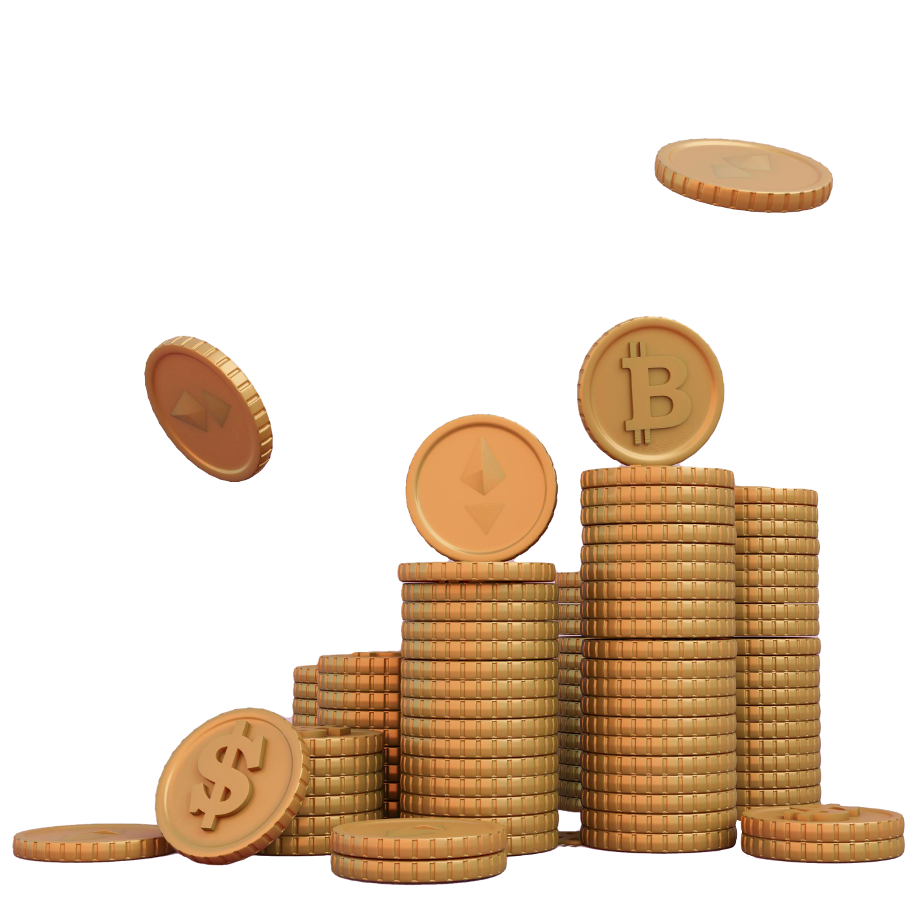





Asset Name Symbol Icon
Binance Coin BNB
Bitcoin BTC
Bitcoin Cash BCH
Ethereum ETH
Litecoin LTC
Cryptocurrencies
Notes:
Chart about the distribution of the cryptocurrencies that we have in the dataset.

Slide 9
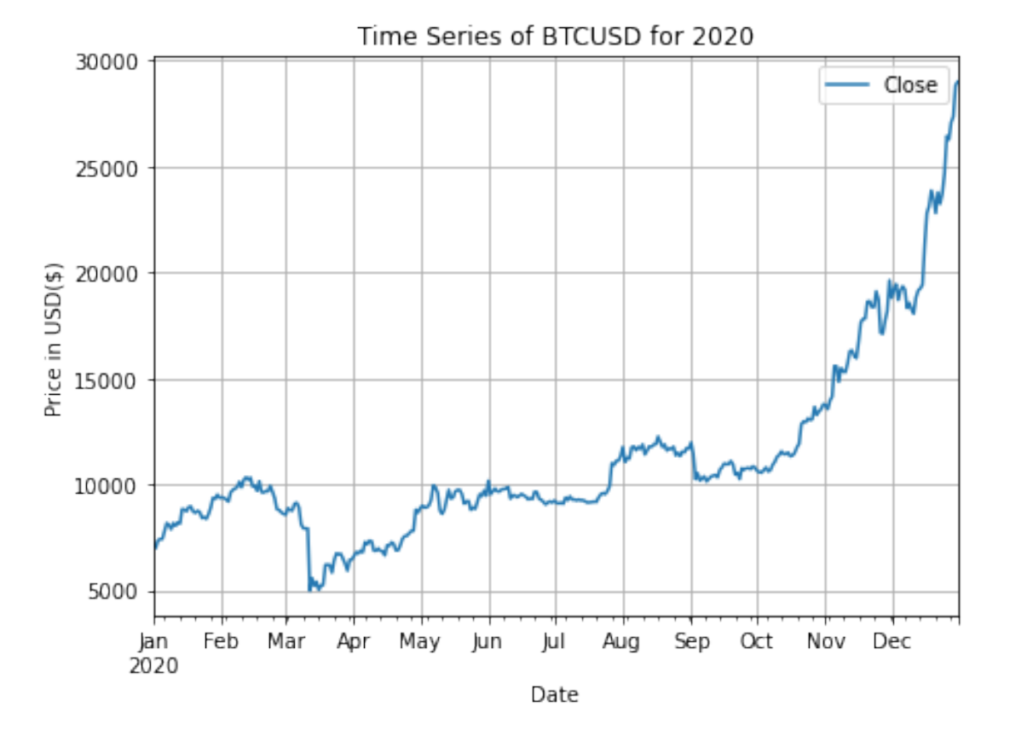
Initial plot of BTC Close prices for the year 2020
BTC has an upward trend & is very volatile
Using the ADF test we noticed that the time series is not stationary
Notes:
The ADF test is used to check if the data is stationary.
By looking at the p-value from the ADF test

Slide 10
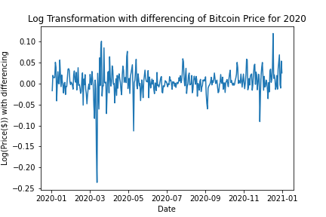
Making the data stationary
To make the data stationary, we applied a log transformation and a differencing

Slide 11
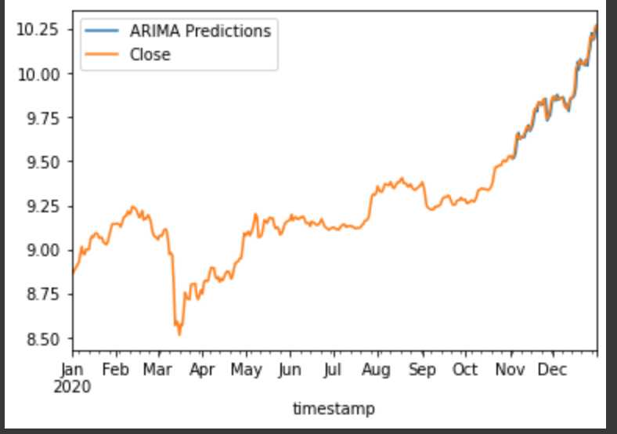
Model Results
Using the RMSE, the model’s accuracy is of 97% in predicting the future price of BTC
Notes:
Add the models predicting the values. The accuracy of the models predicting

Slide 12

Dashboard
Metrics to provide educational guidance

Slide 13

“Our Investments should be consistent with our values”
Hendrith Vanlon Smith Jr.

Slide 14
Acknowledgement
DS4A Staff
Our Teaching Assistants(Jonathan & Sammy)
Our Mentors(Alex Merlis & Krysta Palmer)

